Slide 1

Student@Hub
-Saranya and Nalini

Slide 2
Topics to be covered
Motivation
Features
Tools Used
Working Demo
Future Work

Slide 3
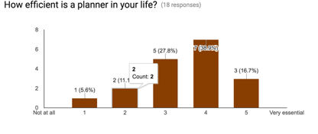
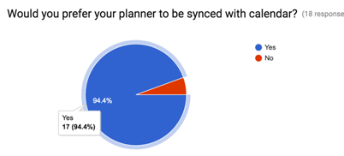
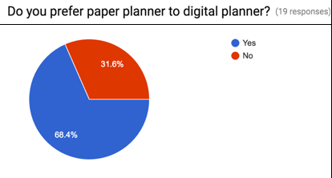
Motivation – Survey on Digital over Paper Planner

Slide 4
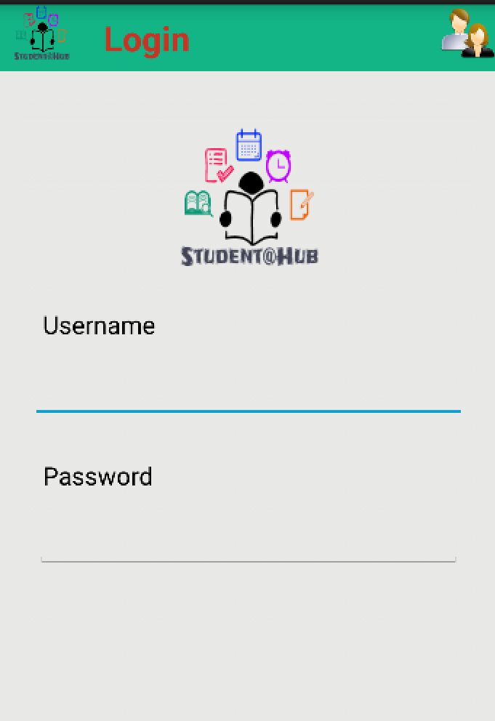
Introduction
As a student, we understand how important PLANNING is
and so we decided to build Student@Hub, an app that
allows interactive schedule planning
The app that allows a student to
Plan
Schedule Events
Create ToDo activities

Slide 5
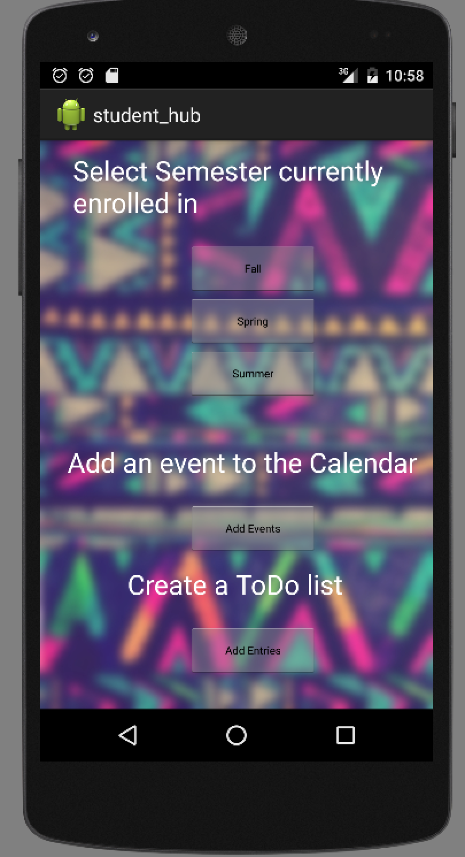
Features of the App
Students can add the Semester they are enrolled in
Select their choice of subjects for a particular semester
Add due dates, event dates to the calendar
Create a ToDo list of activities

Slide 6
Tools Used
Android Studio (SDK) – 2.1
SQLite Manager (provided by Android SDK)
Microsoft Azure
Testing – Samsung Galaxy S3

Slide 7
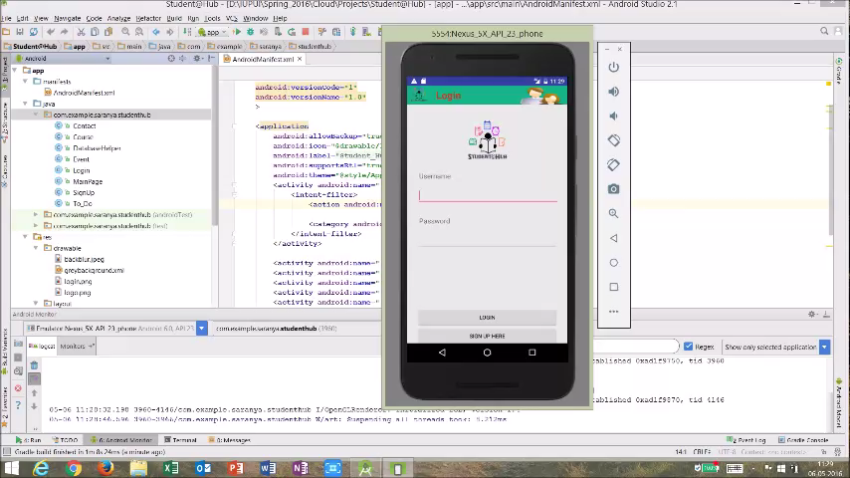
Working Demo

Slide 8
Future Work
Add more user friendly features
Sign up with Google account or facebook
Make available on Android Market

Slide 9
THE APP WILL BE AVAILABLE FOR DOWNLOAD SHORTLY!!! THANK YOU

